Slide 1







Proud to present our AI-based solutions
Riyadh – Cairo - Dubai - Delaware
© Copyright 2018-2025 for TachyHealth. - All rights reserved

Slide 2


TachyHealth, a leading healthcare technology innovator, with cutting edge AI-powered clinical solutions
Founded In September 2018
TachyHealth, and its sister company Enayah, are clinically-led healthcare technology companies with a mission to transform value-based healthcare into a reality through interconnected suite of intelligent systems driven by Artificial Intelligence, Automation, and Data Science. We optimize and disrupt the claims journey for the benefit of making healthcare more value-driven for patients, providers, and payers. Our systems excel on complex healthcare domains including PBM, FWA , claims’ adjudication, statistical analysis, and cost optimizations. We developed best-in-class deep technology solutions, for approvals, reconciliation of claims, and Q&A activities
Present In 4 Countries
TachyHealth
Delaware, US
TachyHealth
Cairo Egypt
TachyHealth
AD, Dubai, UAE
TachyHealth
Riyadh, Saudi Arabia
60+ Multidisciplinary Team Member across7 Countries
150+ Million Claims
On Our Systems
1.3+ Billion USD Worth Of Claims Passed On Our Systems
“Our purpose is to drive an actionable value-based healthcare by transforming the interaction between providers and payers through Artificial Intelligence and data science”
2

Slide 3



Proven Success
Our Traction in Numbers
$1.3B
Value of claims processed
97%
Predictive Accuracy
TachyHealth leverages AI, automation, and data science to enhance value-based healthcare. We optimize the medical journey with advanced systems for medical necessities, coding, analysis, and cost savings. Our deep technology solutions are best-in-class.
250M+
Claims processed on our systems
3,850+
Embedded Medical guidelines
1.1B
Activities Powering our systems
3

Slide 4






We're revolutionizing healthcare with our AI-powered platform, enhancing the end-to-end patient journey for a smarter, seamless experience
Fit for Purpose
Accuracy
High Performance
Predictability
4

Slide 5

Healthcare Cycle Challenges
Rising Healthcare inaccurate diagnosis with high investigation Costs
Inconsistent medical necessity decisions
Complex regulations and coding variability
Delayed claims processing & poor auto-adjudication rates
Losses due to Fraud, Wase, and Abuse
High Operational Expenses (OPEX)
5

Slide 6
Our technology is our secret sauce
A multi-layered enterprise platform that meets the highest standards on the cloud.
While as a micro-service solution, it can be used as a whole bundle or single service, we can integrate with all systems through API or be installed on in-house servers.
Unmatched processing speed is met with our cloud servers, that takes 100K claims to be processed, milliseconds to respond with recommendation, minimal time to analyze and interpret scans or investigations, leverages AI & NLP capabilities, and is backed by a robust proprietary solutions.
6

Slide 7





AI Transformation For Healthcare Providers
Our Value-based
Healthcare Solutions
Notes:
Our Vision: To empower payers with intelligent, scalable, and evidence-based AI tools to ensure fair, fast, and accurate healthcare funding decisions

Slide 8












Creating The Utopia
Building the intelligent systems at each interaction point
Ai Care
A Mini EMR system
A decision support solution
Automated medical Coding
Claims & Approval Automation
Fraud, Waste, & Abuse Identifier
Pharmacy Benefit Management
Underwriting Policy Management
Automates eligibility checks, Automates appointments scheduling, Serve Nurse, Physician, laboratory & Radiology Module.
A Hybrid model (rule-based and AI) decision support, diagnosing and recommending treatment plans.
Convert free-text medical data into structure codes ICD, CPT, DRG auto-coding.
CM, AM, WHO
AI Powered automation for validating and reviewing claims and prior approval.
Predictive analytics and pattern detection engine for payer-level insights, fraud, overuse, and clinical trends.
Applies AI to manage pharmacy benefits, adjudicate medication claims, monitor prescriber practices, and align with formulary guidelines.
Transforms underwriting guidelines into AI-readable rules. Applies underwriting rules for eligibility and policy checks.
Supported by

Slide 9


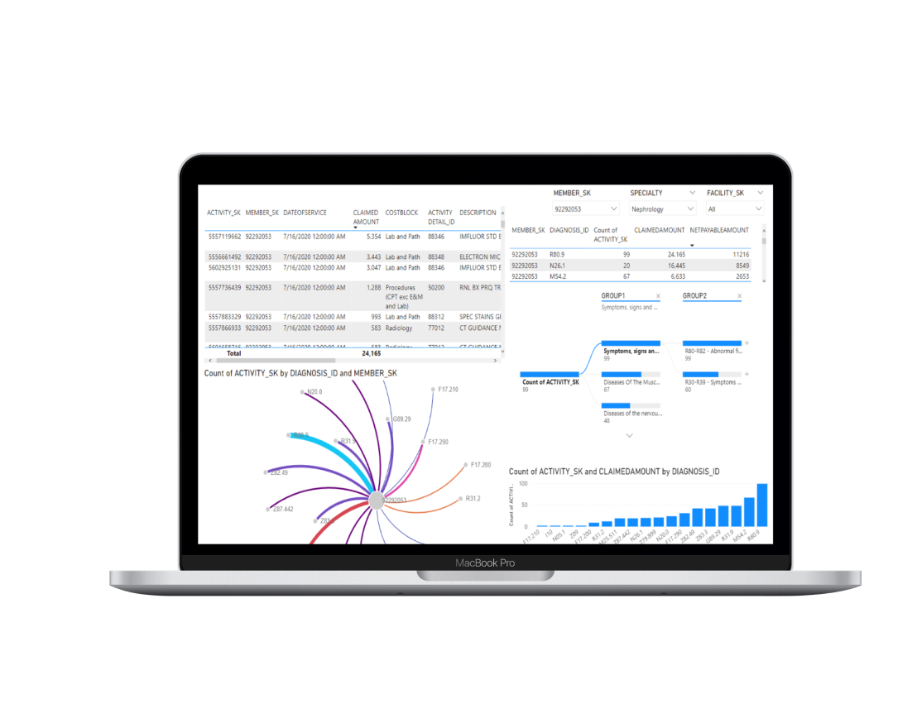


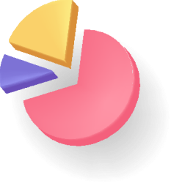



Real-Time Analytics and Dashboard
Our 360Insights tool provides comprehensive tracking of all claims-related activities and interactions. It visualizes key performance indicators (KPIs) and insights through a real-time dashboard, leveraging advanced models and big-data analytics.
Powered by

Slide 10











Our Unique Value Proposition
End to End Automation
Maximize Revenue
Minimize Denials
Enhance Productivity
From claims processing to policy management, all workflows are streamlined.
Improve accuracy and speed of claims
Real-time adjudication
and reviewing
Automated reviewing for huge batch of claims
10

Slide 11







Significant reduction in fraud, waste, and abuse losses.
Accelerated claims adjudication and approval process. (100k activities in less than 10 mins)
Automation of a substantial percentage of audits and investigations.
Seamless AI adoption eliminating reliance on legacy systems.
Real-time dashboard for proactive decision-making and improved fraud detection.
Measurable Results
&
Business Impact

Slide 12



















Large scale partnerships
We are proudly working with some of the best healthcare clients in MENA
Integrations In-Progress
Following the regulations of
Empowered and supported by
Research and academic partners
Private and Highly Confidential
Notes:
Add GIG
Add Iqvia
Add IA instead of SAMA

Slide 13



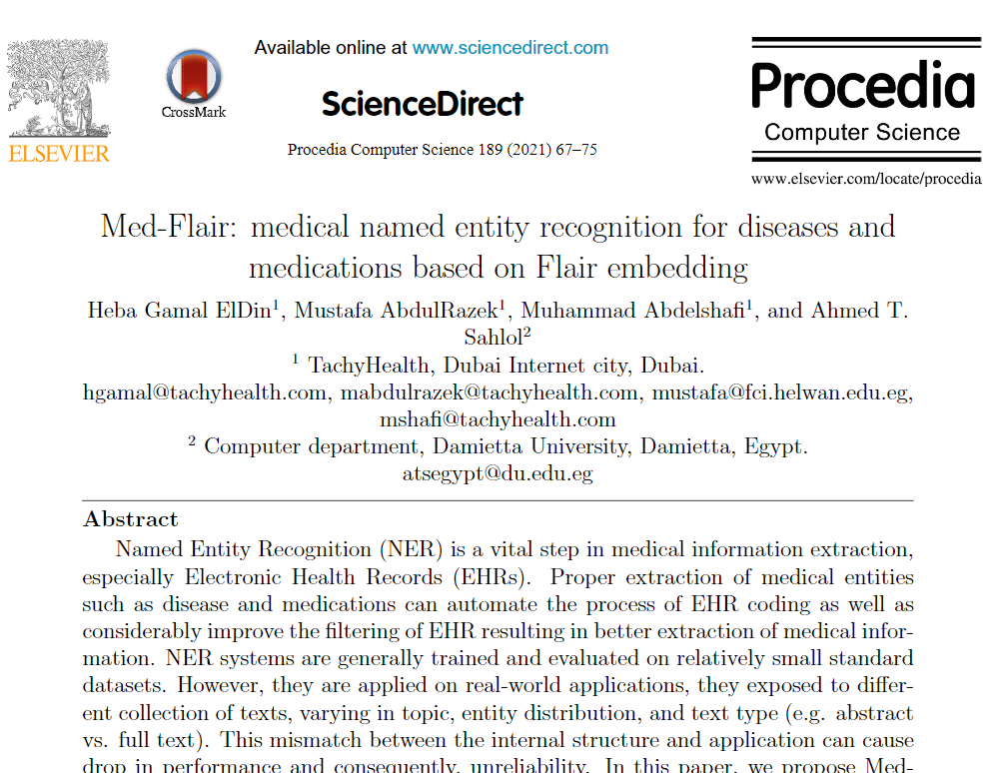
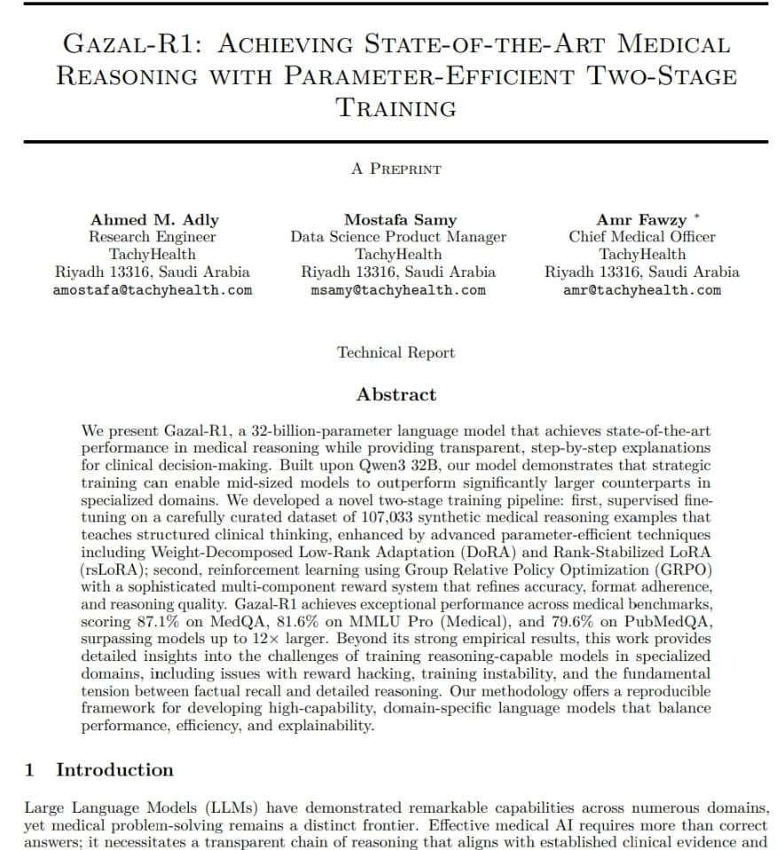
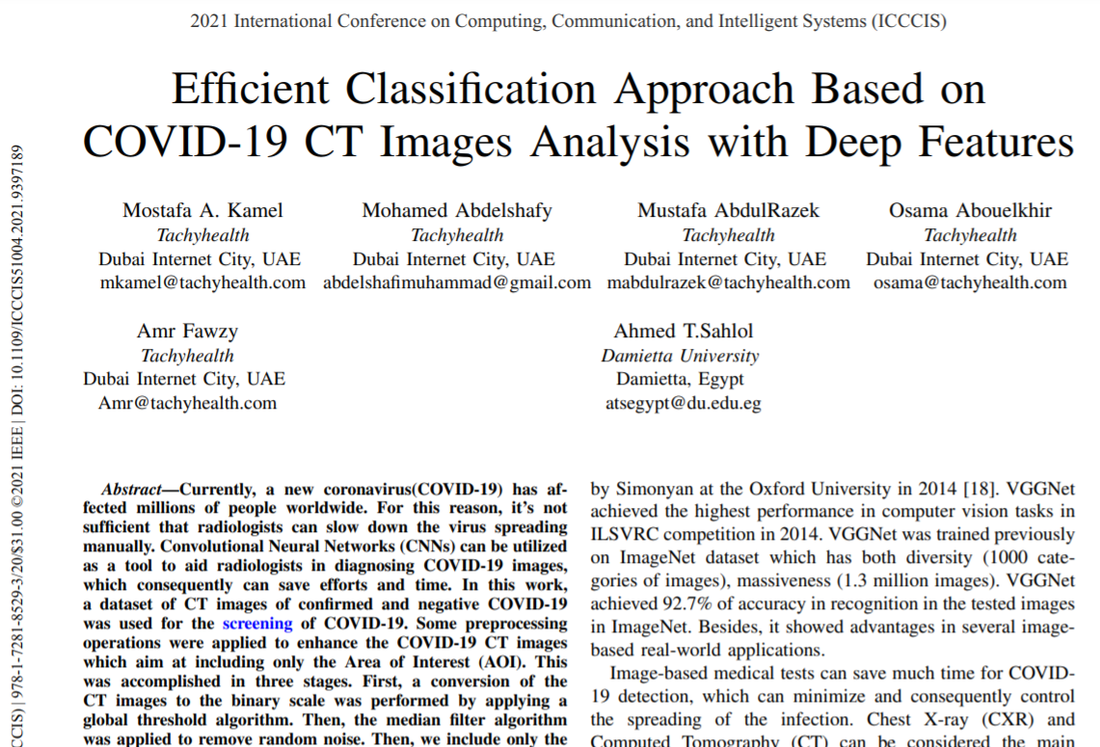


Our research publication
We mix research with development and published in peer-reviewed journals
Sources: 1) Medical named entity recognition 2) COVID-19 detection in CT images

Slide 14
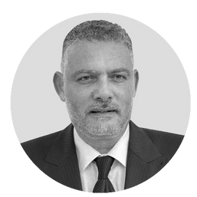

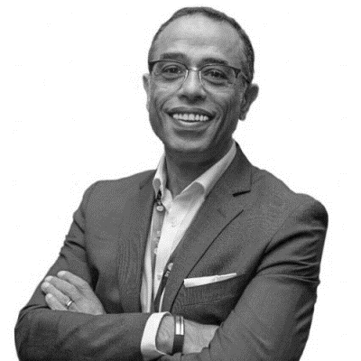
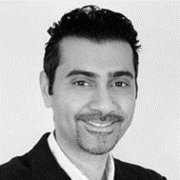
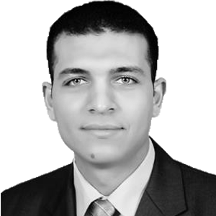
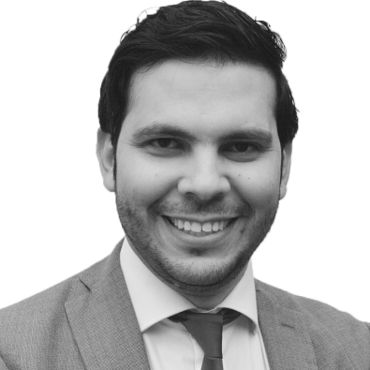




















100+ Years' Experience, $100M+ Projects: Our Team's
Unmatched Medical Expertise
Dr. Osama AbouElkhir, MD
CEO
Dr. Amr Fawzy, MD
COO
Jamal AlNasser
CCO
Mo Khadra, MBA
CTO
Dr. Ahmed Talaat, PhD
Head of AI Research
A medical doctor, management consultant, and high-tech executive, with +13 years of experience in strategic and operational management in the healthcare. He worked in hospitals, big4 advisory firms, and digital health startups with +$20M projects and solutions. He oversees the building of the solutions while meeting the client expectations.
A fellow of the Royal College of Surgeons-Ophthalmology and Arizona University for pediatric ophthalmology. He has +30 years of experience. He’s a co-founder of +$20M Egyptian chain of eye hospitals (Dar EL Oyoun), where he played a major role in its strategic & operational functions. He’s the chairman of WeCare that has been working on healthcare developments in Africa.
Dynamic business leader with over 27 years of high caliber experience in management consulting, healthcare, medical devices, regulatory affairs, and business development in the Middle East and USA where he established and maintained successful relationships (including "trusted advisor status)with C-Suite executives (Ministers and Deputy Ministers in government organizations)
A technology and data analytics executive with +15 years of experience in technology and wireless communication. Mo is a computer scientist and holds an MBA from Washington State University. He led many big data/analytics projects for Fortune 500 companies like Ericsson, Verizon and AT&T in USA and MENA. He oversees the technology and data sciences.
A well-versed researcher in machine and deep learning with +12 years of track record of applying scientific programming in his AI researches. He published +20 studies including Nature Research with special focus and interest on healthcare. He was a visiting PhD researcher at center for machine intelligence at Concordia University in Canada. He. He oversee the AI researches.

Slide 15






For further information, contact us.
amr@TachyHealth.com
www.TachyHealth.com
jalnaser@TachyHealth.com
www.enayah.ai

